Slide 1

Aránzazu Gil Casadomet
CIVIS Euro-African LaCoTT Laboratory (Languages, Communication, Translation & Technologies; https://www.lablacott.com/)
OpenLab 2026 – Co-Creation for Digital Equity: Civic Technologies and Multilingual Communication in Service-Learning Projects across Europe and Africa
Website localization

Slide 2


Table of Contents
What is localization in the translation market?
Static and dynamic websites
Localizable computer products: websites
Computer languages: programming and mark-up languages
Processing of computer language code: HTML mark-up language
Technical translation
Linguistic difficulties: borrowings
Passolo 2022 & Trados Studio 2024
Conclusions
Bibliographic References

Slide 3
What is localisation in the translation market?
According to The Localization Institute, localisation is the process of creating or adapting a product for a specific place — that is, for the language, cultural context, conventions, and requirements of a specific target market. With a properly localized product, a user can interact with it using their own language and cultural conventions. It also means that all user-facing messages and all documentation, whether printed or electronic, use the user’s language and cultural conventions. Finally, a properly localized product meets all regulatory and other requirements of the user’s country or region. (Cf. https://www.localizationinstitute.com/)
Regional variants
Character sets
Currency, numbers, date, time
Cultural context, colors
Hot keys
Text direction
Measurement systems
Keyboard layout

Slide 4
Static and dynamic websites
Static websites are made up of a set of documents in HTML language, CSS to define their presentation styles and JavaScript acting as a control during the interaction with the user. In addition, it is that page mainly focused on displaying permanent information, where the surfer is limited to obtain this information, without being able to interact with the visited web page. Examples are portfolios, digital CVs, company presentation pages, etc. [Ex1] [Ex2]
Dynamic websites store and manage a large amount of information in order to be able to present it according to a user's request or to certain conditions. Thus, the main difference at a basic level with the static website is that in this case the contents are not fixed. In addition, it is one that contains applications within the website itself, such as surveys and voting, support forums, guest books, sending intelligent e-mails, product reservations, online orders, personalised customer service, etc. They are designed in PHP language. The computer resource that allows information to be stored and managed are databases. More specifically, CMS (Content Management Systems) or Content Management Systems. The best known of these is WordPress. [Ex3] [Ex4]
It is important not to confuse multimedia and interactivity. A static website can be multimedia (video, sound, images...) and interactive through links and hyperlinks, without being dynamic itself. However, it will not contain interactive applications in which the user obtains information through dialogue boxes for example.
In this case, the formats of the documents to be translated can be PO, JSON, MS-Excel, HTML, XML, XHTML, XLIFF, etc.

Slide 5
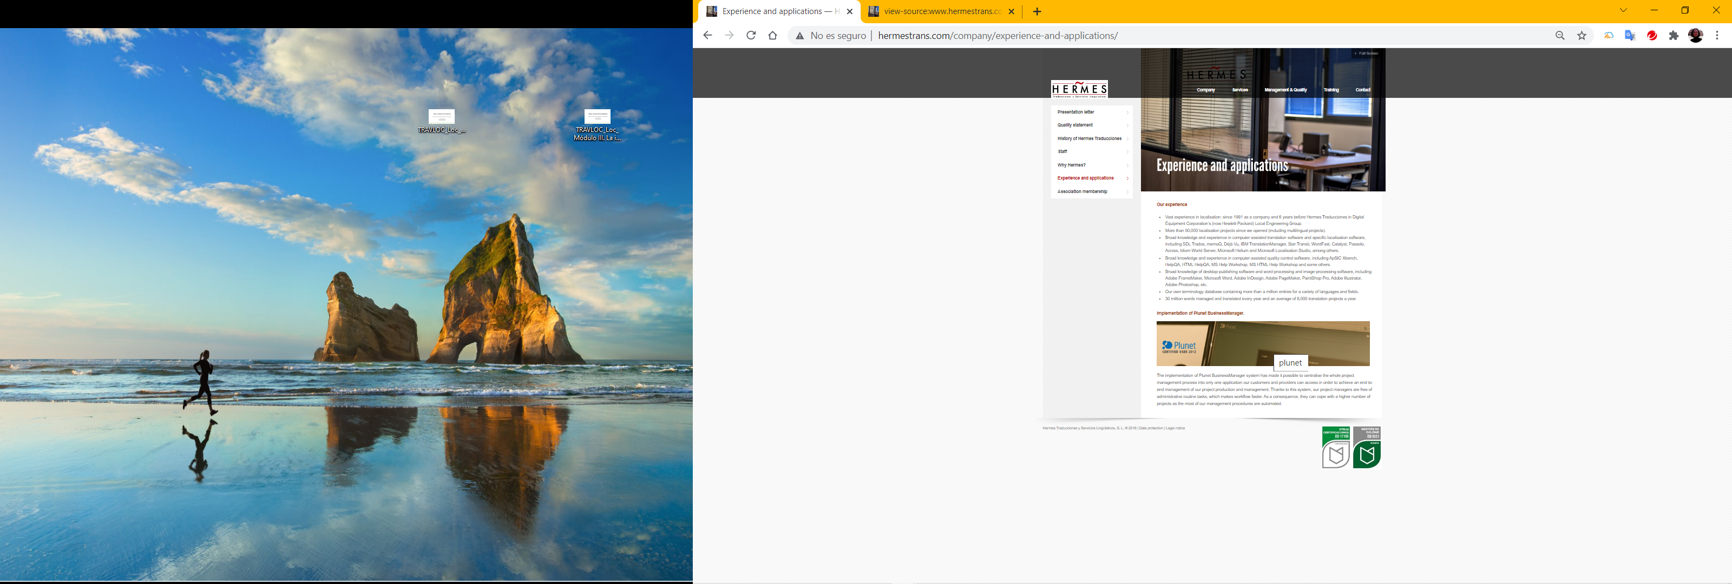
Localizable computer products: websites
Graphic and multimedia elements
We can classify the elements found on a website into three groups:
a. Information elements: text and formatting data, dynamic and static information structures, and script-based programming routines. → The text is localized and translated.
b. Graphic and multimedia elements: these include any type of graphic commonly used on the Internet, such as GIF, JPEG, PNG, and Flash, as well as video and audio files in formats supported by HTML or controlled by external applications. Pay attention to the “alt” element. → The text in graphic and multimedia elements is localized and translated, as is the “alt” element.
c. Programming elements: these include JAVA applications, ActiveX, and, less and less often, Flash, as well as the elements used to manage the website’s structure (PHP, ASP, etc.). → Metadata or tags are neither localized nor translated.
Information elements
‘alt’ elements
Programming elements: press Ctrl+U on the website

Slide 6
Computer languages: programming and mark-up languages
A computer language is a language used by computers and is used by programmers and web developers to create computer programmes, desktop applications, mobile device applications, web applications, etc.
Among computer languages, we find programming languages such as JavaScript, C++, Python, PHP, which is the means used by programmers to create a computer program; we also find mark-up languages that are the means to describe to a computer the format or structure of a computer document, such as HTML, XML, XLIFF (Ferrero Martinez 2015; Gómez Palomo & Moraleda Gil 2020).
The source code is the internal interweaving encoded with a set of metadata whose functions virtualise interfaces that are manageable and suitable for a non-programming brain. Translating the code will require minimal knowledge of the particular programming language because it is usually done directly on the code file. And if the source code is modified, the web page or application may stop working (Oliver 2016).

Slide 7
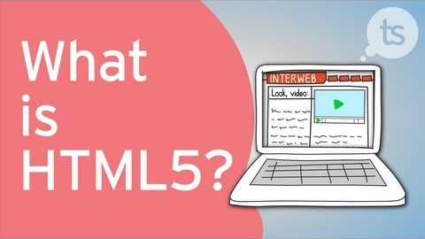
Processing of computer language code: mark-up languages
HTML mark-up language
Video ‘What is HTML, HTML4 and HTML5’
Tags and metadata in XML, HTML and XHTML mark-up languages

Slide 8
Technical translation
Technical language is approached in the translation process from the exclusive parameter of terminological specificity. The elements of technical language are the expressive forms proper to the subject matter, the qualities proper to style, and the capacity of the receiver. (Olivares Pardo, 2000: 105)
The translation of computer products involves using techniques such as borrowing (external elements such as neologisms), either without modification (roaming) or naturalized (customizing); calque, or literal, lexical, or syntactic translation, of a word or phrase in the target language (free on board/franco a bordo); and the established equivalent, which corresponds to the use of a term or expression recognized by linguistic usage as equivalent in the target language and culture (at your fingertips/al alcance de su mano). (Diéguez and Lazo, 2011: 306)

Slide 9
Linguistic difficulties: borrowings
“All languages owe something to the others, and these two in particular: French has nourished English, and English has enriched French. But over the last half-century, the ‘linguistic balance’ between the two languages has clearly become deficit in French’s detriment. […] To the historical influence of Great Britain has been added the demographic, commercial, scientific, and cultural weight of the United States, which marked the second half of the twentieth century.” (Voirol, 2006: 11; our translation)
English > Spanish
Website – information element: www.shopify.es. “Shopify - E-commerce Platform” / “The Best E-commerce Platform”.
Website – information element: www.sas.com/es_es/home.html. “SAS Web Analytics is a revolutionary and comprehensive solution that combines the power of customer relationship management with the analytical intelligence of SAS” / “SAS Web Analytics is a revolutionary and far-reaching solution that combines the power of customer relationship management and the company’s analytical intelligence.”

Slide 10
English > Spanish
Website – graphic and multimedia elements: www.zara.com/es. Login/Logout – “Sign in / log out”.
Website – graphic and multimedia elements: www.brother.es. View shopping – “View cart”.
Software – menu options: AutoCAD. Shortcuts – “Keyboard shortcuts”.
Software – context menu: Photoshop. Export to Behance – “Export to Behance”.
English > French
Website – information element: www.amazon.fr. Return an order – “returning an order”.
Website – graphic and multimedia elements: wordpress.com/fr. Daily webinars – “Daily webinars”.
Software – menu options: Norton Antivirus. Cleanup – “Cleanup”.
Software – messages or strings: SDL Passolo. Localisation in progress… – “Localization in progress…”.

Slide 11


Passolo 2022 & Trados Studio 2024
Passolo 2022
Creation of a localization project: import of files (HTML, .exe, or XLIFF) and integration of linguistic resources (TMX and TBX) for content localization.
Trados Studio 2024
The exercise consists of combining the use of terminological databases (TBX) with neural machine translation and AI-based machine translation within Trados Studio 2024.

Slide 12
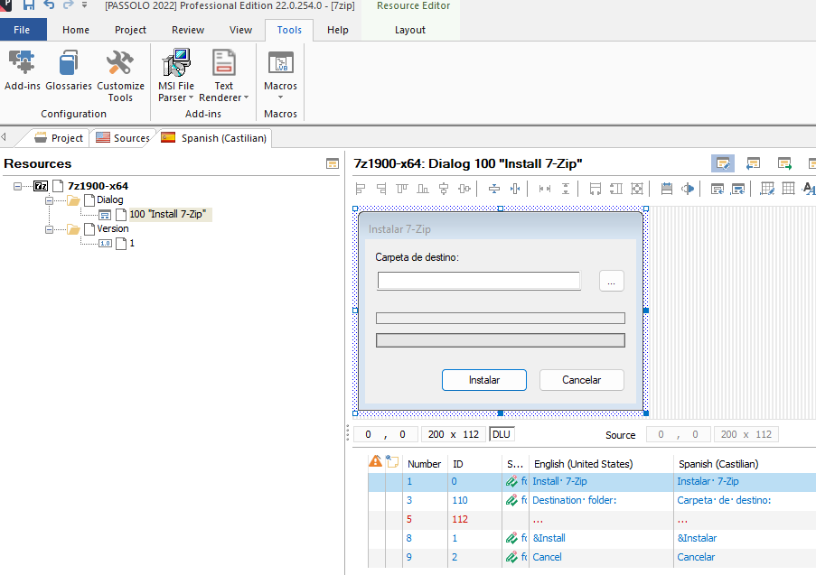

Slide 13
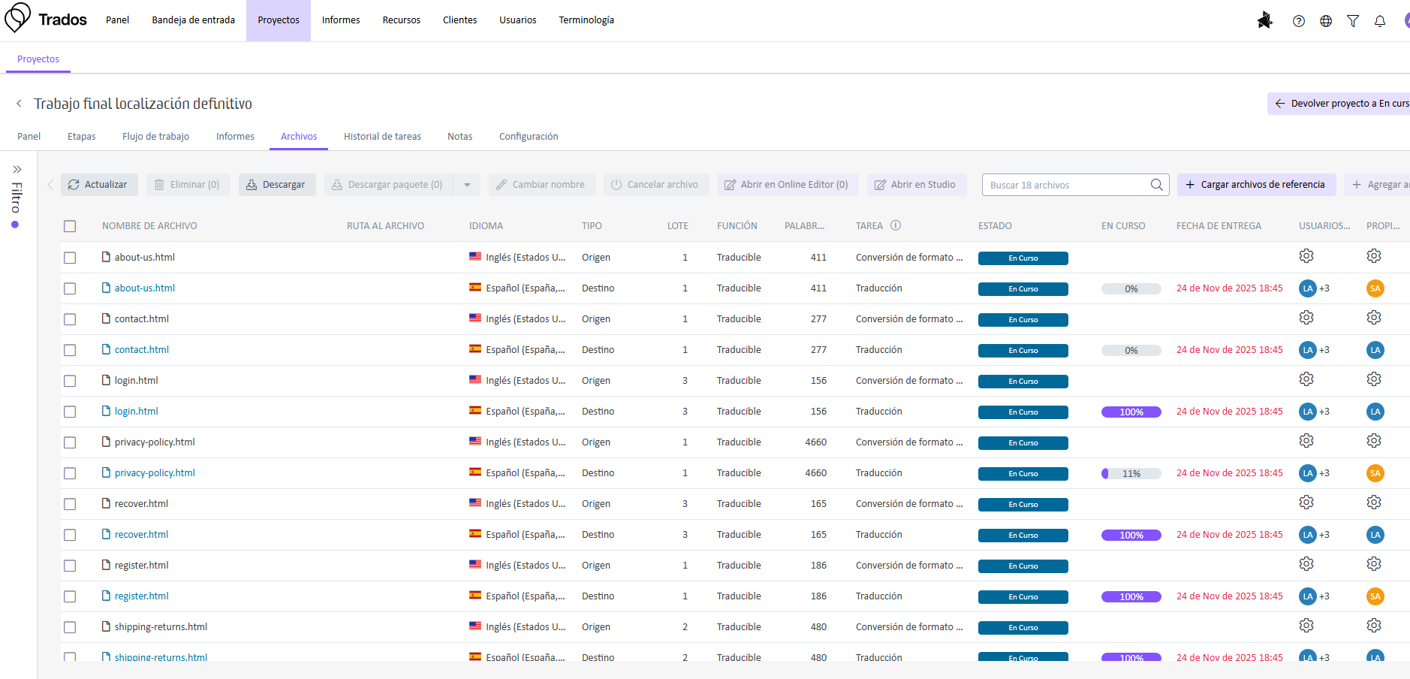
https://eu.cloud.trados.com/

Slide 14
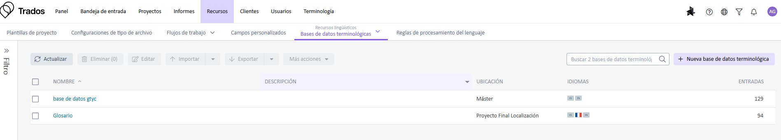

Slide 15
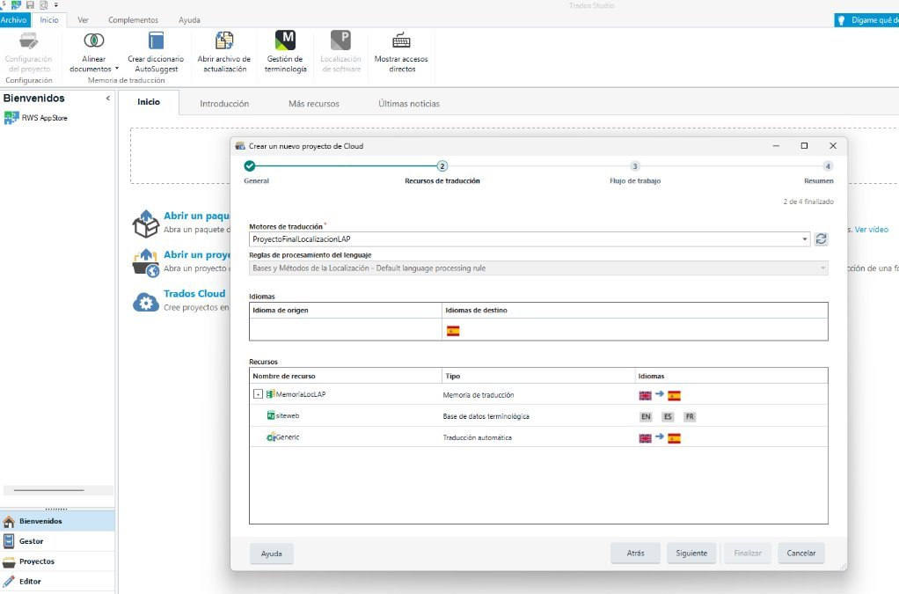

Slide 16
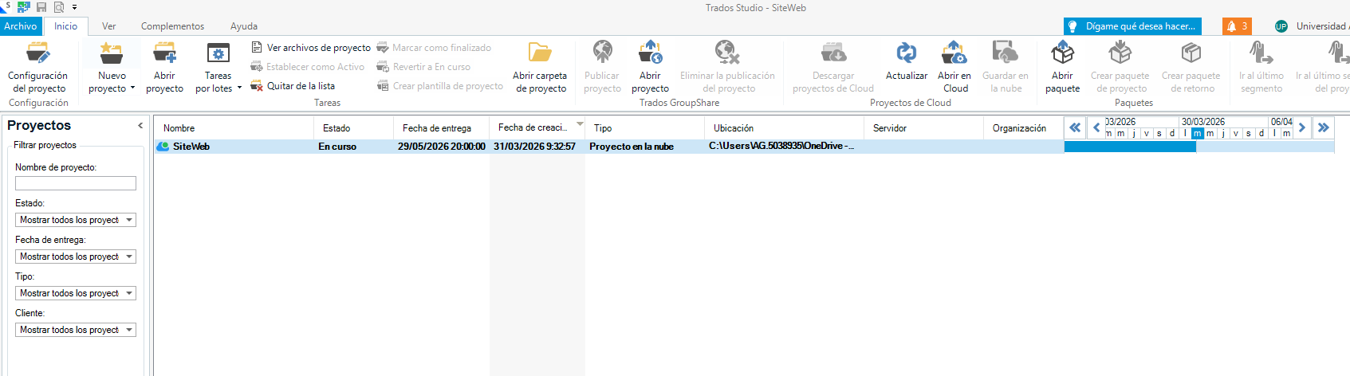

Slide 17
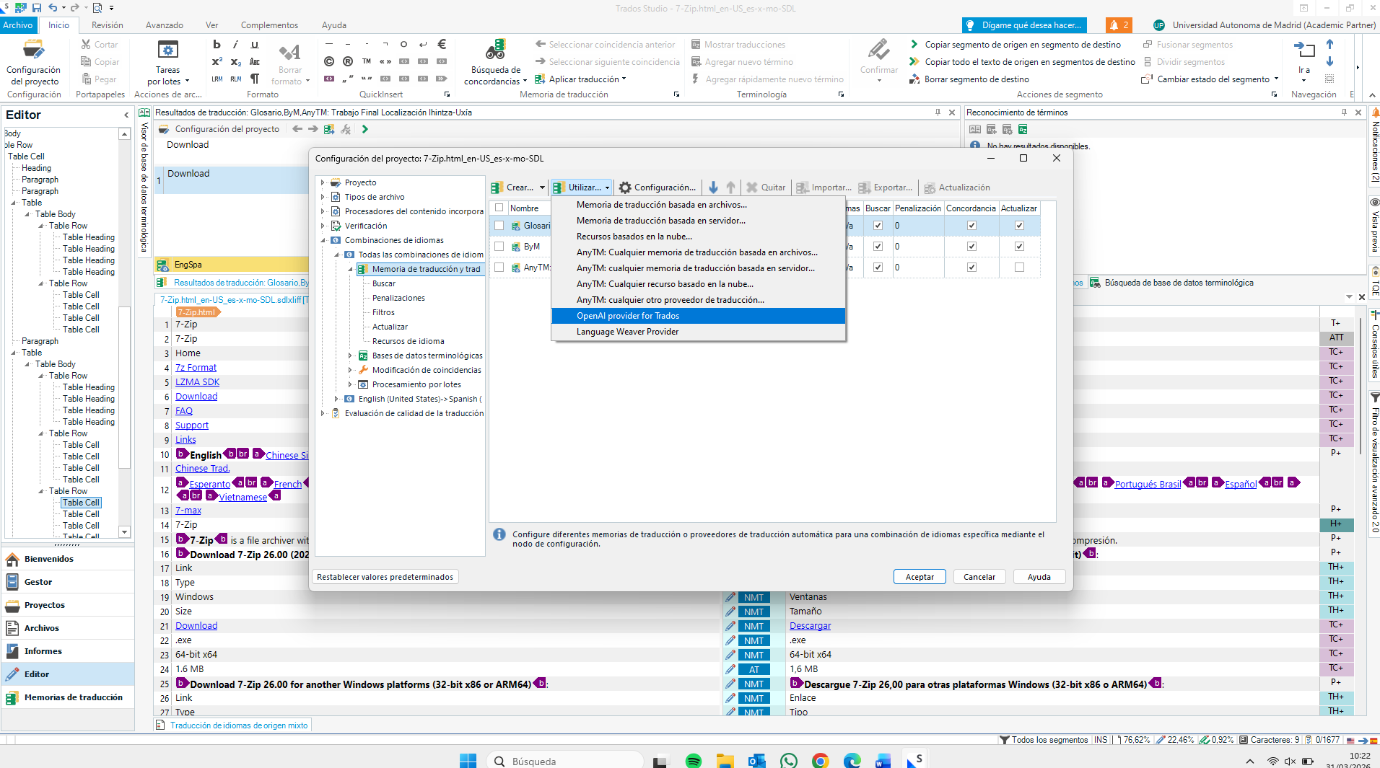

Slide 18
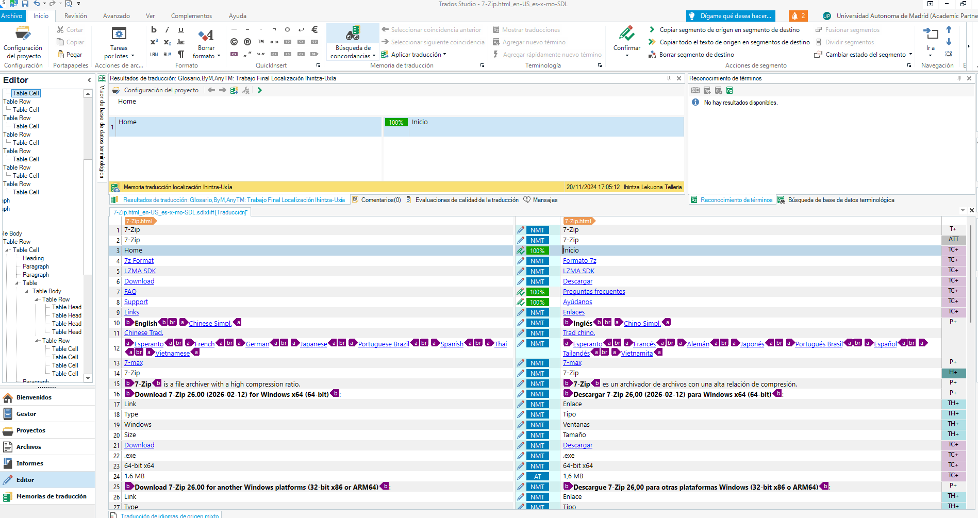
TA neuronal
TA OpenAI

Slide 19
Conclusions
Website localization is not just about translating words, but about adapting content, interfaces, and functionalities to the linguistic and cultural expectations of the user. In this process, elements such as text, images, formats, links, and even system messages must be carefully reviewed to ensure a natural and coherent user experience.
Moreover, localization shows that digital translation is an interdisciplinary task that requires linguistic, technical, and cultural skills. For this reason, the translator’s role in this field goes beyond verbal equivalence: it involves making decisions that affect the accessibility, usability, and communicative effectiveness of the final product.
In short, localizing a website means making it truly functional for a specific market. In a global and multilingual environment, this ability has become an essential tool for communicating accurately, respecting users, and ensuring the international presence of companies, institutions, and digital projects.

Slide 20
Bibliographic References
Jiménez, E. S. (2016): “A general view of the localization of apps for mobile devices: status, challenges and trends. Formats and customary processes in the translation of iOS and Android apps”. Tradumàtica: traducció i tecnologies de la informació i la comunicació, 14, 5-15. https://raco.cat/index.php/Tradumatica/article/view/316835
Jimenez Crespo, M. A. (2024). Translation in localization. Routledge.
Lommel, A., & DePalma, D. A. (2021). Augmented translation: how artificial intelligence drives productivity and efficiency for the language industry. Common Sense Advisory Report, February 2021.
López Sánchez, R. (2025). IA en traducción professional: herramientas, usos prácticos y límites éticos. Traduversia.
Tercedor Sánchez, M. (2010): “Translating web multimodalities: Towards inclusive web localization”. Tradumàtica. Traducció i Tecnologies de la Informació i la Comunicació, 8. https://revistes.uab.cat/tradumatica/article/view/n8-tercedor/pdf_20
Uren E., Howard R. y Perinotti, T. (1993): Software Internationalization and Localization: An Introduction. Van Nostrand Reinhold.
Voirol, M. (2006 [1989]): Anglicismes et anglomanies. Éditions Victoires.

Slide 21


